Slide 1
Section Divider Slide

Slide 2
Microsoft Azure Governance Immersion Day
Notes:
Add name of primary proctor and their tile to this slide

Slide 3
Microsoft Azure Governance Immersion Day
Welcome!
Sirius Intro’s
<Insert Name & Title>
<Insert Name & Title>
<Insert Name & Title>
<Insert Name & Title>
Notes:
All proctor’s and team members should do a quick introduction of their name, title and role in today’s workshop. If necessary cover things like WiFi access and location of restrooms, lunch or any other logistical issues that might be appropriate.

Slide 4
Microsoft Azure Governance Immersion Day
<Customer Name> Intro’s
Team 1
<Insert Name & Title>
<Insert Name & Title>
<Insert Name & Title>
<Insert Name & Title>
<Insert Name & Title>
Team 2
<Insert Name & Title>
<Insert Name & Title>
<Insert Name & Title>
<Insert Name & Title>
<Insert Name & Title>
Notes:
Customer attendee’s should do a quick intro of name, title, team they work with and what they are hoping to get out of today’s Azure Governance Gameday.

Slide 5
Microsoft Azure Governance Immersion Day
What Are the Topics For Today?
Organization Hierarchy
Management Groups
Subscriptions
Resource Groups
Naming Conventions & Standards
Tags
Azure Policy
Azure Blueprints
Identity & Access Management
Notes:
Also go over what the intention is for the workshop today. Example: This Immersion Day is intended to help you understand how you can use Azure to manage, secure and govern your azure environment by either matching what you are doing on-premises or creating a new governance model for Azure.

Slide 6
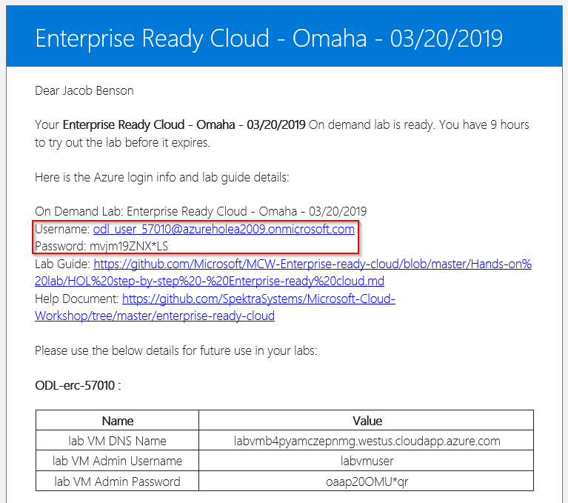
Lab Signup
Go to:
<Insert Bit.ly Link Here>
Notes:
Let them know we are doing this first because it takes a while for the lab environment to get created. When they get the activation email it will have some information in it, the only thing they need is the username and password to login to the Azure portal (although the VM information might or might not come in handy).

Slide 7
Microsoft Azure Governance Immersion Day
Sample Agenda (Key Word is Sample!)
9 – 9:30 AM: Kickoff and Introductions
9:30 – 10:45 AM: Azure Governance and Organization
10:45 – 11:00 AM: Break
11:00 – 12:00 PM: Azure Management Groups and Subscriptions
12:00 – 12:30 PM: Lunch
12:30 – 1:00 PM: Resource Groups
1:00 – 1:30 PM: Naming Conventions and Standards
1:30 – 2:00 PM: Tags
2:00 – 3:30 PM: Azure Policy & Initiatives
3:30 – 3:45 PM: Break
3:45 – 4:30 PM: Identity and Access Management
4:30 – 5:00 PM: Azure Blueprints
Notes:
Clearly state that the attendee’s may not get all the way through this today (and the expectation is that most or not any of them will make it all the way to the end. Explain that this is not a traditional workshop where we would stand up and give a presentation and then they would work through a checklist of steps. This is a challenge based hackathon focused on learning topics and applying them to your business. The challenges describe high-level goals and tasks to be accomplished. Proctor’s are here to provide guidance (not answers) unless there is something blocking progress. Proctor’s will force you to learn the content rather than providing answers. All timelines are completely negotiable!

Slide 8
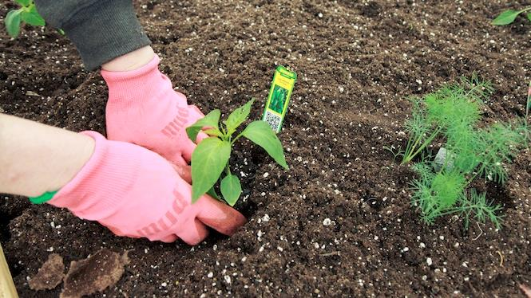
You Will Get Your Hands Dirty!
Notes:
You only get out what you put in, don't be lazy.
Knowledge Retention through Pain and Discomfort

Slide 9
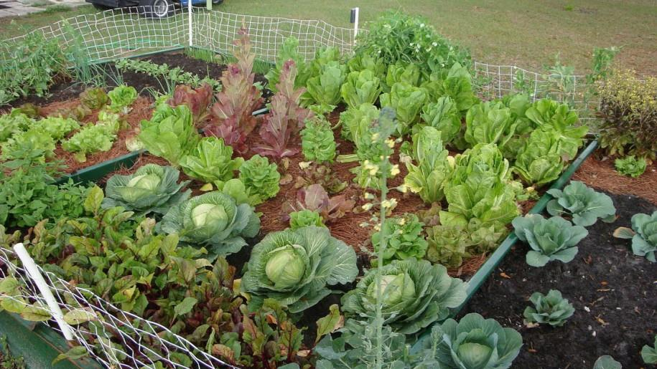
What Will Your Garden Look Like?
Notes:
You might not grow a garden like this… but at least you can learn while trying.

Slide 10

Logistics

Slide 11
Format
Challenges are cumulative, building upon each other.
Start small and simple
Build competence by having successively more complex challenges
Challenges are NOT step-by-step hands on labs!
No “clicking here” or “copy and paste there”
Challenge definitions are short. A couple of sentences or bullet points stating the end goal(s) and perhaps a hint at the skill(s) needed.
You MUST work together as a team to figure out how to complete them!
Notes:
We are going to start small and simple (think HELLO WORLD), establishing confidence in the material and the process.

Slide 12
Format
For each challenge we will deliver a “mini-lecture” explaining the concepts in it
We’ll review each challenge when it looks like a majority of folks have completed the challenge
Don’t worry about how much time something is taking!
Move quickly or take it slow. Your proctors are here to help
Remember, the focus is on learning!
There WILL be more challenges than you can complete in our allotted time! These are takeaways to follow up on.

Slide 13
Tooling
You can use any tooling you want, but we strongly encourage (and will only support the following):
Visual Studio Code
Azure PowerShell
Azure CLI
Azure Cloud Shell
Notes:
This slide may not be appropriate depending on the Gameday. Feel free to modify/hide as necessary.

Slide 14
Finding Answers
Search engines are your friend! Azure is a hot technology and much ink has been spilled on it.
The Azure docs are your best bet!

Slide 15
Proctor Responsibilities
Keep the teams working as teams!
Encourage all to “learn from” and “share with” each other!
If you observe individuals racing ahead, encourage them to help those who are behind.
Unblock teams who get stuck
Encourage team members to unblock each other first!
Provide hints, but not answers
Provide hints/pointers to the teams on how to solve problems & where to find information.

Slide 16
Attendees Responsibilities
Learn
Do
Learn
Share
Learn

Slide 17
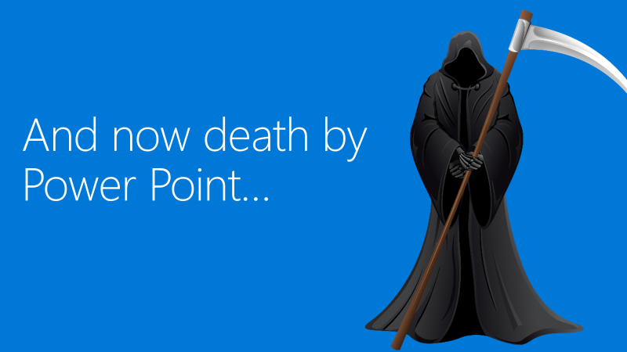

Slide 18
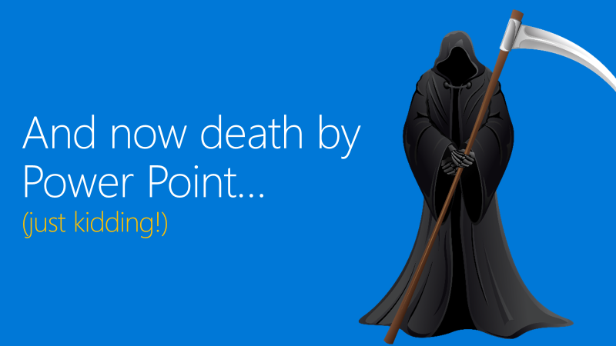

Slide 19
Header Only

Slide 20
Object Slide

Slide 21
Double Column Slide

Slide 22
Double Column with Header Slide

